Slide 1
Twitter Crawler Component

Slide 2
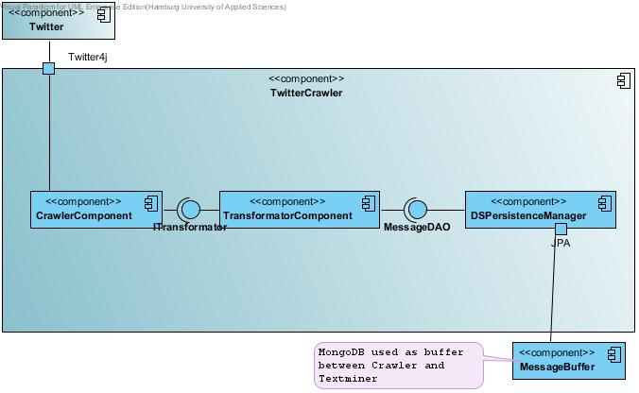
Funktion

Slide 3
Function - Search
Searchrequest to Twitter

Slide 4
Function - Search
found Tweets

Slide 5
Function - Transformation
Tweet -> Message

Slide 6
Function - Store
Store message in MessageBuffer

Slide 7
Crawler Component
Twitter4j Framework -> Twitter Search API
450 Zugriffe/15min(100 Tweets / Zugriff) ->
45000 Tweets/15min
Twitter Trends

Slide 8
Transformator Component
Umwandlung der Tweets in abstraktes Message Format

Slide 9
Message - Format
Author
Message
Tags
PostTime
Geodata
PictureUrls
Provenance

